Slide 1

Fault Tolerance and Recovery Techniques in Distributed Operating Systems
Ch.sai Prakash-192110061
L.Venkata sai-192210403
B.Priyanka-192111524

Slide 2
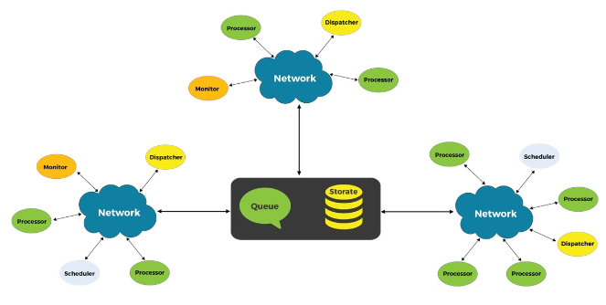
Introduction
Distributed operating systems are designed to handle complex tasks by leveraging multiple interconnected machines.
Fault tolerance is crucial in these systems, ensuring seamless operation even when individual components fail.
This presentation explores various techniques to achieve resilience and enable rapid recovery.

Slide 3
Importance of Fault Tolerance in Distributed Systems
Data Integrity
High Availability
Scalability
Fault tolerance guarantees that the system can continue to function despite individual component failures, ensuring high uptime and reliability.
Recovery techniques like checkpointing and replication protect against data loss, maintaining the consistency and integrity of critical information.
Fault-tolerant distributed systems can scale more effectively by dynamically adjusting resources and gracefully handling increased workloads.

Slide 4

Replication Techniques for Fault Tolerance
Primary-Backup Replication
One primary node handles requests, with backup replicas ready to take over in case of failure.
Quorum-Based Replication
Data is replicated across multiple nodes, and a quorum of nodes must agree on updates.

Slide 5
Quorum-Based Protocols for Fault Tolerance
Read Quorum
Quorum Intersection
Write Quorum
A majority of nodes must agree on the data before a read operation can complete.
Ensuring that read and write quorums overlap to maintain consistency.
A majority of nodes must acknowledge a write operation before it can be committed.

Slide 6



Consensus Algorithms for Fault Tolerance
Paxos
A leader-based consensus protocol that guarantees consistency despite failures.
Raft
ZooKeeper
A simplified consensus algorithm that is easier to understand and implement.
A coordination service that uses Zab, a Paxos-like protocol, to ensure consistency.

Slide 7
Conclusion and Future Trends
Key Takeaways
Fault tolerance is crucial for reliable distributed systems
Replication, checkpointing, and quorum protocols enable recovery.
Consensus algorithms ensure consistent state despite failures.
Future Developments
Advancing consensus algorithms for faster convergence.
Adaptive fault tolerance for dynamic cloud environments.
Leveraging emerging technologies like blockchain for fault tolerance.

Slide 8


